Slide 1
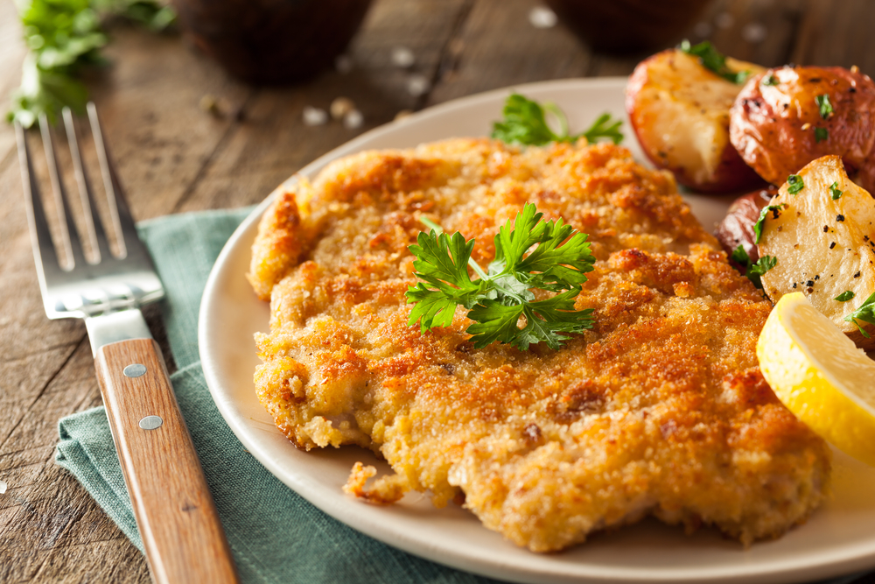
An Examination of Recipes from Around the World
Benjamin W. Sturm
bwsturm@gmail.com
June 1, 2018
Notes:
Hello! I’m going to be presenting on an examination of recipes from around the world.

Slide 2
The goal of my project was to use data science to gain insights of cuisines from around the world.
Questions I wanted to explore:
Which cuisines are most similar and which are most different?
Are there any unexpected relationships?
Can we use topic modeling to separate out different cuisines?
Notes:
The goal of my project was to gain insights of cuisines from around the world using data science techniques.
In particular, some questions I wanted to try and answer are:
- Which cuisines are most similar and which are most different?
Are there any unexpected relationships between the different cuisines?
Can we use topic modeling to separate out different cuisines?

Slide 3
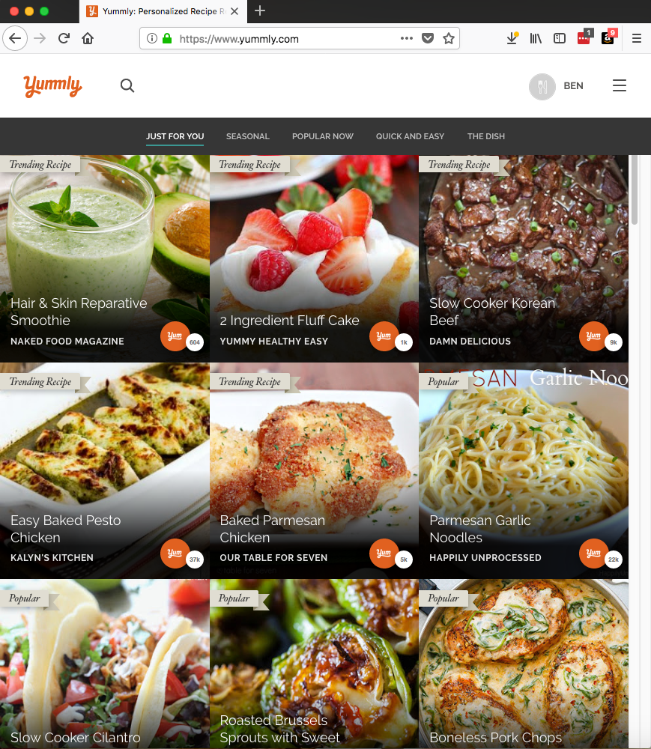
In order to explore this topic, I used publicly available recipe data
Yummly.com API
Data Description
Name | Type | Description
Cuisine | String | e.g. italian, indian, mexican
Course | String | e.g. Lunch, Main Dish
Flavors | Dict | e.g. {sour: float, salty: float, sweet: float}
Ingredients | List of Strings | e.g. [bow-tie pasta, bacon slices]
Rating | Int | Rating from 1-5
RecipeName | String | e.g. ‘Lemon Chicken Pasta’
Size of data:
Total number of recipes downloaded: 12,492
Total number of cuisines: 25
Number of recipes / cuisine: ~500
Notes:
In order to explore this topic, I used publicly available recipe data. In particular, I used the Yummly api to search for recipes based on cuisine. This table summarizes my data. In total, I collected over 12,000 recipes from over 25 different cuisines throughout the world.

Slide 4
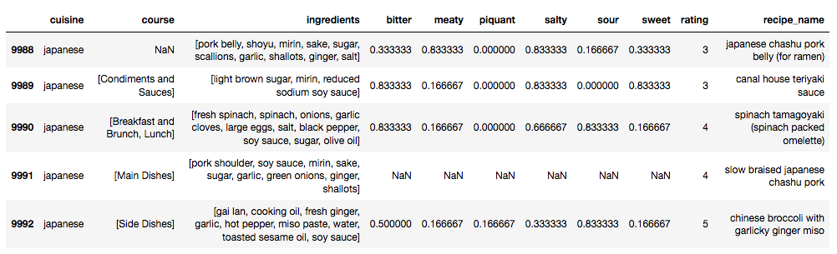
Before implementing machine learning, a number of preprocessing steps were necessary
Example of the dataframe
Summary of preprocessing steps:
Hyphenating certain ingredients (e.g. olive-oil, corn-starch)
Removing stop words and other frequently occurring words (e.g. salt, pepper, water)
Stemming by dropping plural forms of words and other suffixes
Bag-of-words processing
Notes:
Here I’m showing a representative example of the dataframe that contained the recipe data.
click
I only used the ingredients column for all my machine learning models that I’m presenting on today.
Of course I had to implement a number of preprocessing steps on my data such as:
hyphenating certain ingredients
removing stop words and other frequently occurring words
stemming to get rid of plural words
And finally bag-of-words processing
Once that was completed, I could move on to more interesting things such as PCA.

Slide 5
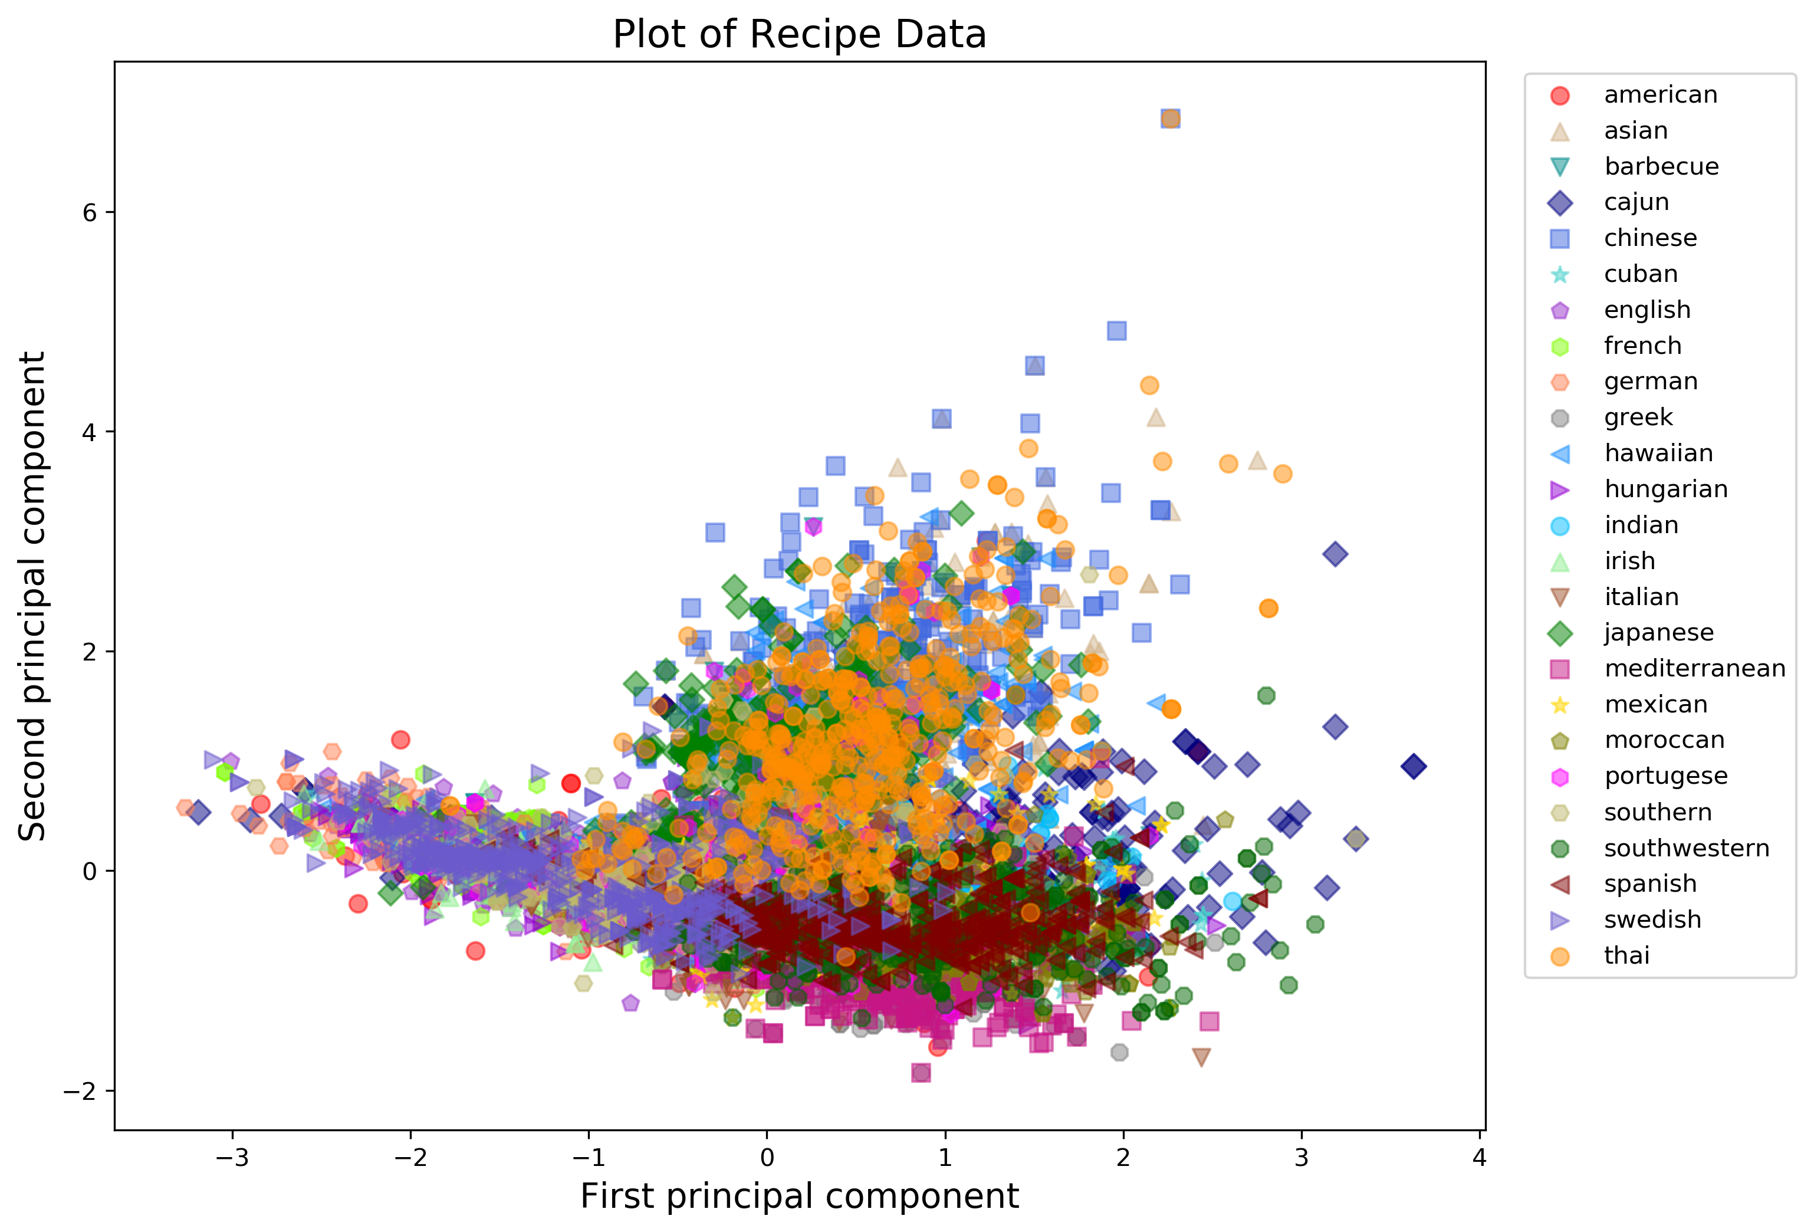
Applying PCA to the recipe data results in many overlapping points
Notes:
This is a scatter plot of the 12000+ different recipes along the first two principal components after applying PCA. This isn’t very insightful, because there are too many overlapping data points.

Slide 6
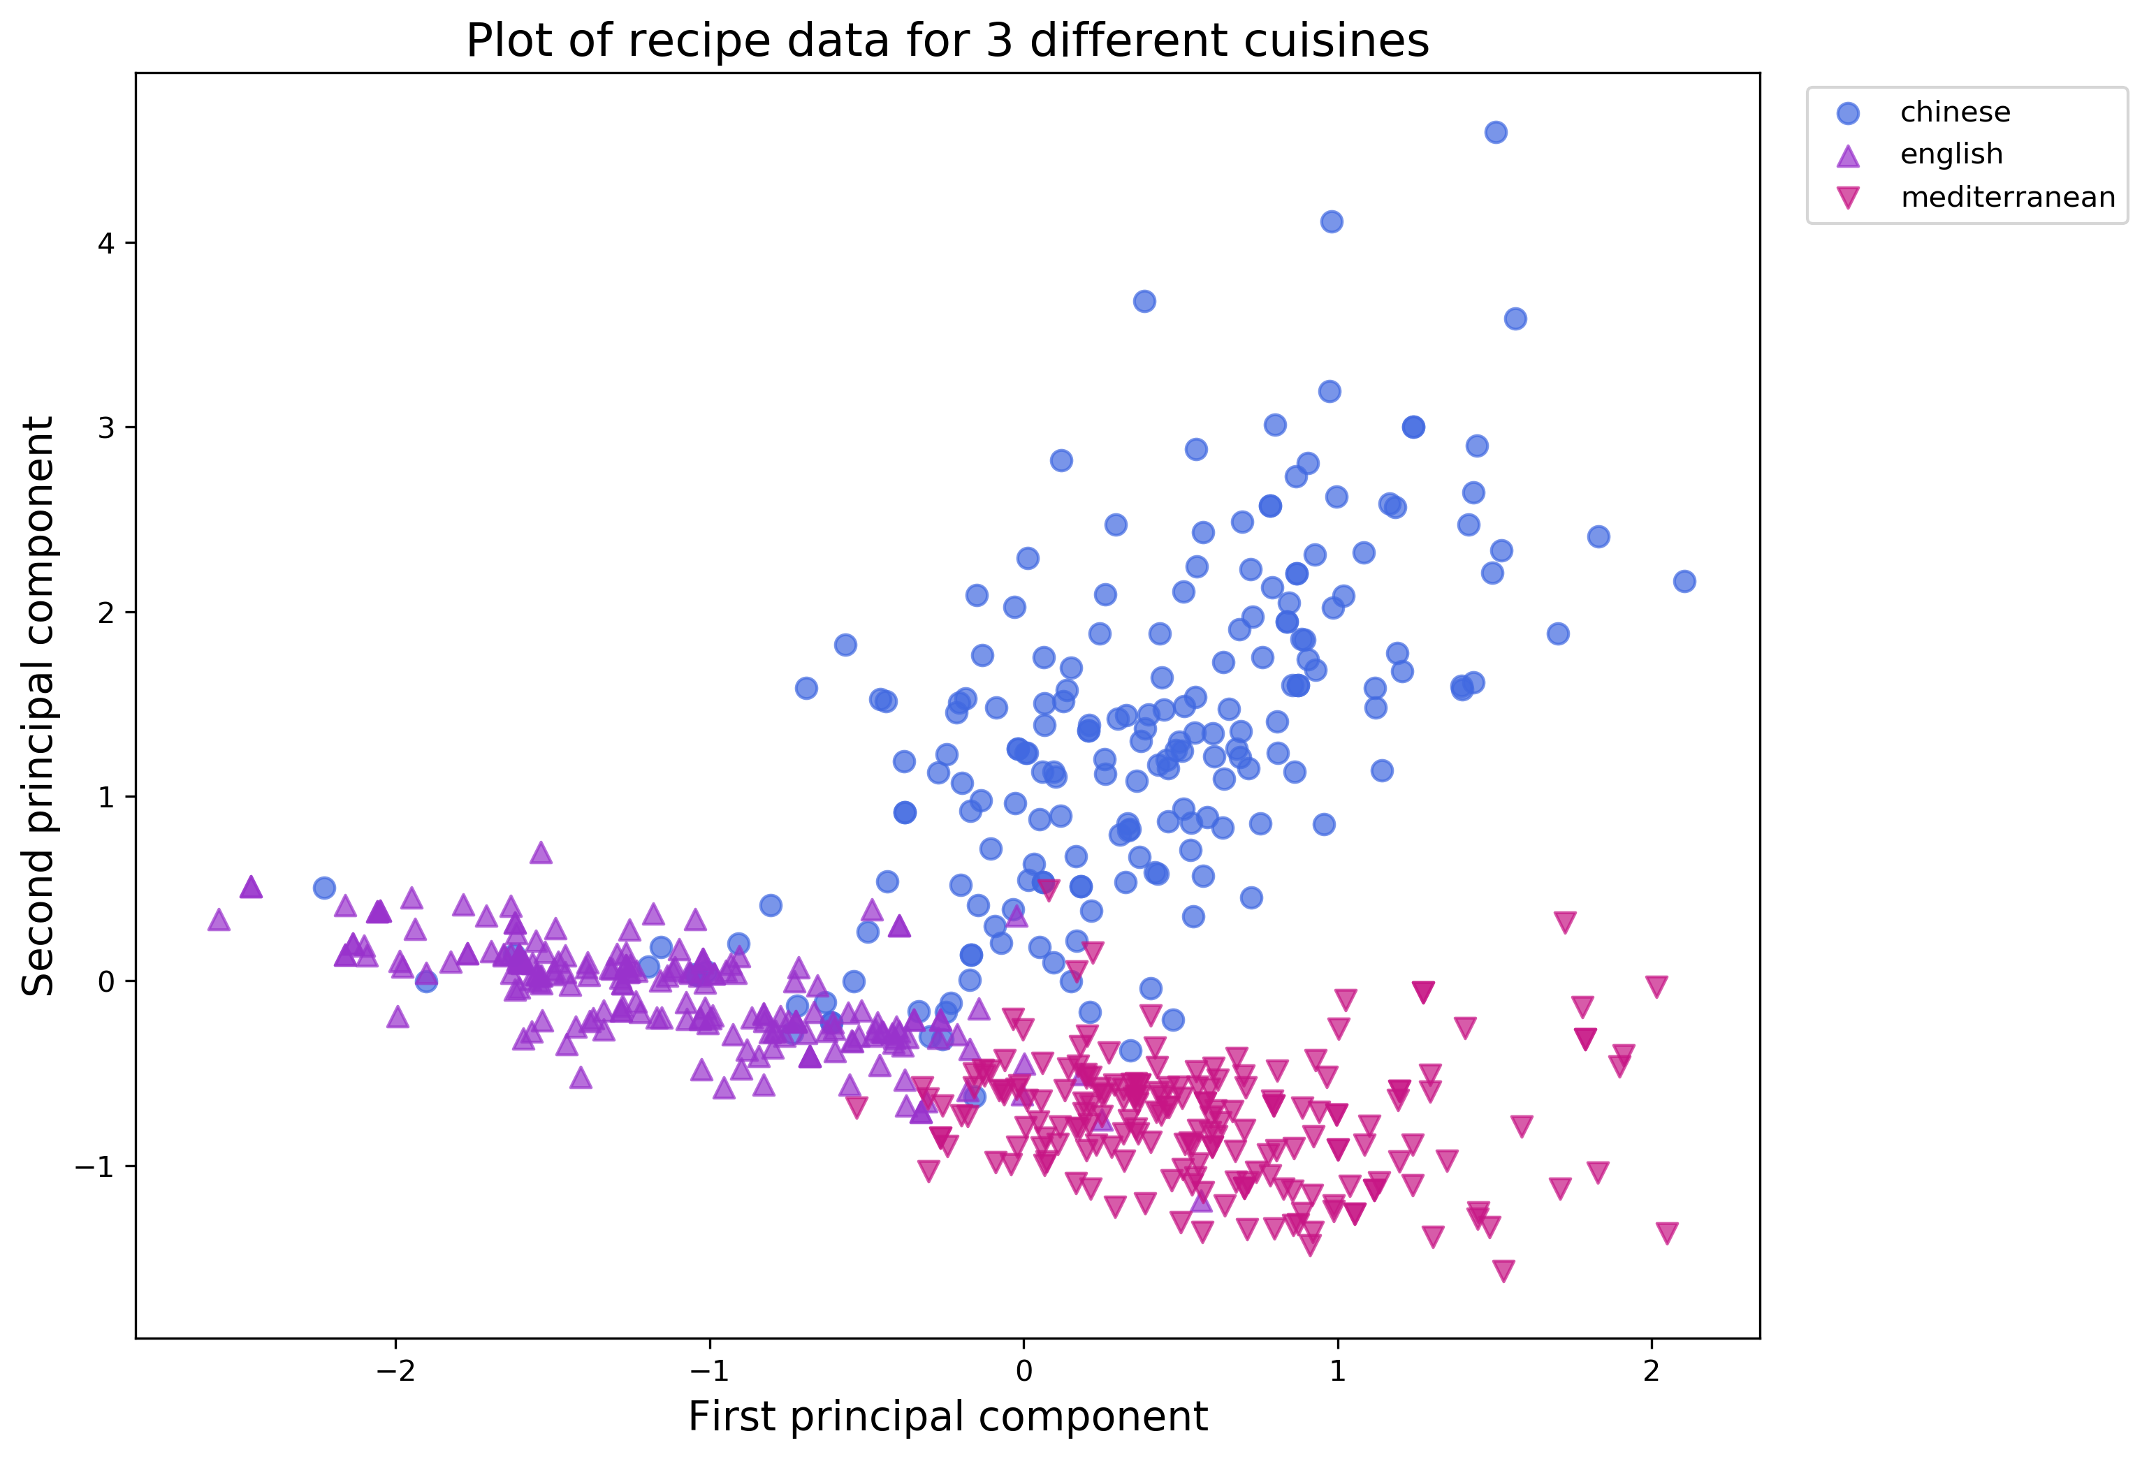
A much clearer separation is observed when we focus on 3 different cuisines
Cocktails
Notes:
However, if we focus in on three different cuisines only, namely Chinese, English, and Mediterranean, we can start to see some clear separation in the data. These recipes are clustered together in this 2D space based on cuisine, which is interesting.

Slide 7
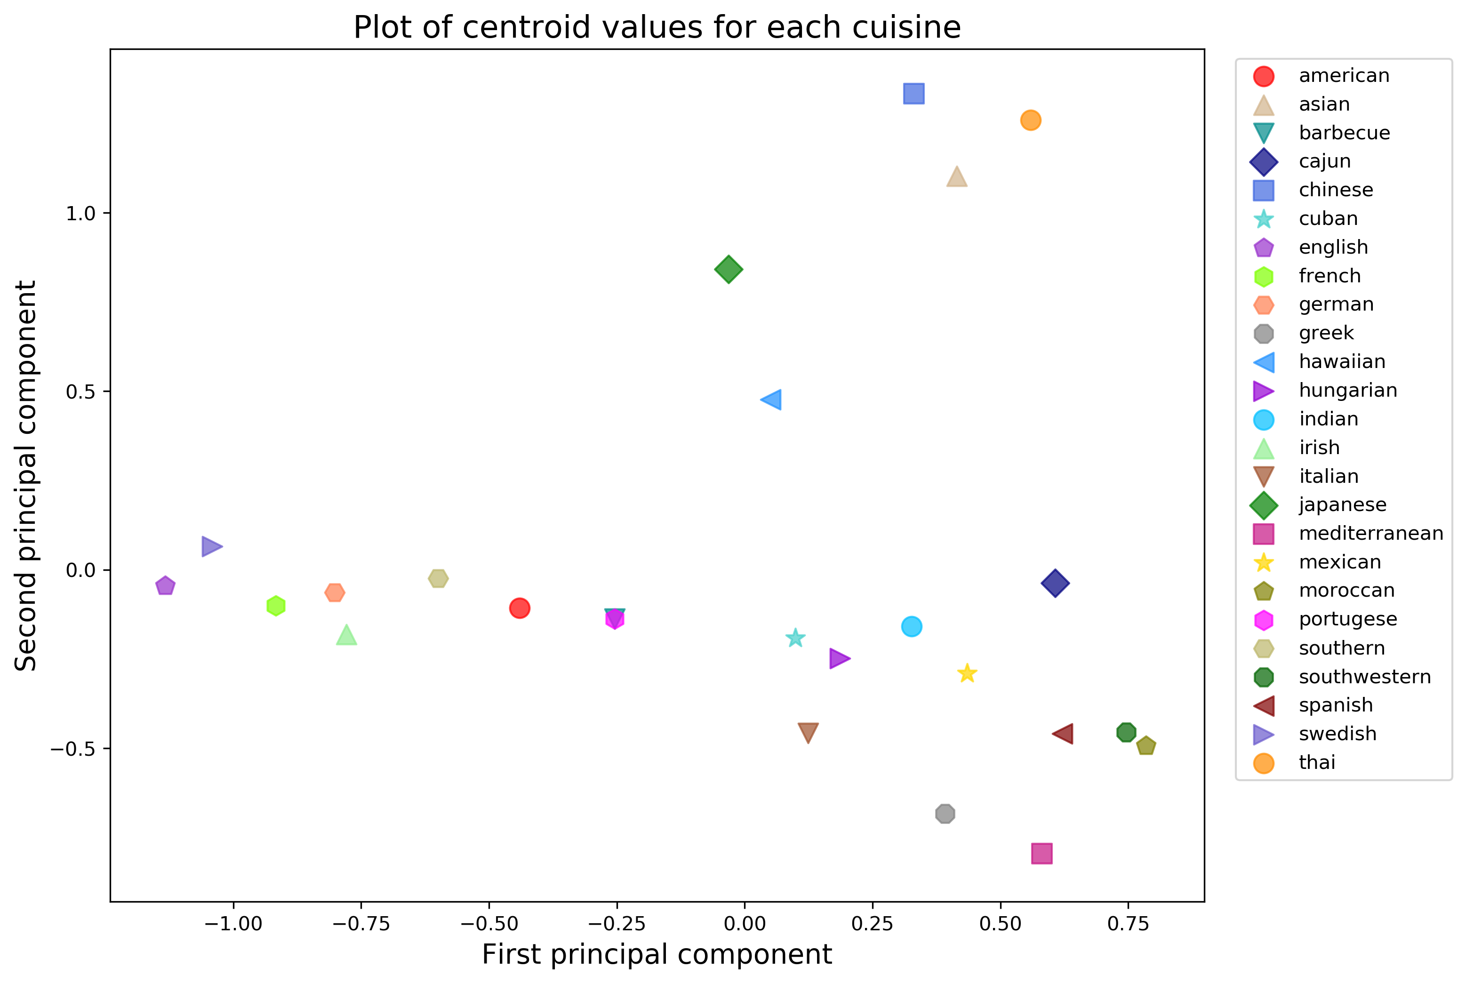
Now observing the centroids for each of the cuisines, we can see some patterns
Asian
Japanese
& Hawaiian
European
American
Renegades
Notes:
Now I’m showing a plot of the centroids for each of the cuisines along each principal component. So, what I did was grouped the recipes based on cuisine and took the mean value for the first principle component and the mean value for the second principle component. Here we can start to see some patterns in the data:
Click
This region consists of different types of Asian cuisines
Click
This region consists of Japanese & Hawaiian cuisines, which are heavily fish based
Click
This region contains European cuisines
Click
And not too far away are American cuisines which are composed of traditional American, southern, and bbq
Click
Lastly we have the group I have dubbed the Renegades which includes Cuban, Mexican, Italian, Mediterranean, and Cajun.

Slide 8
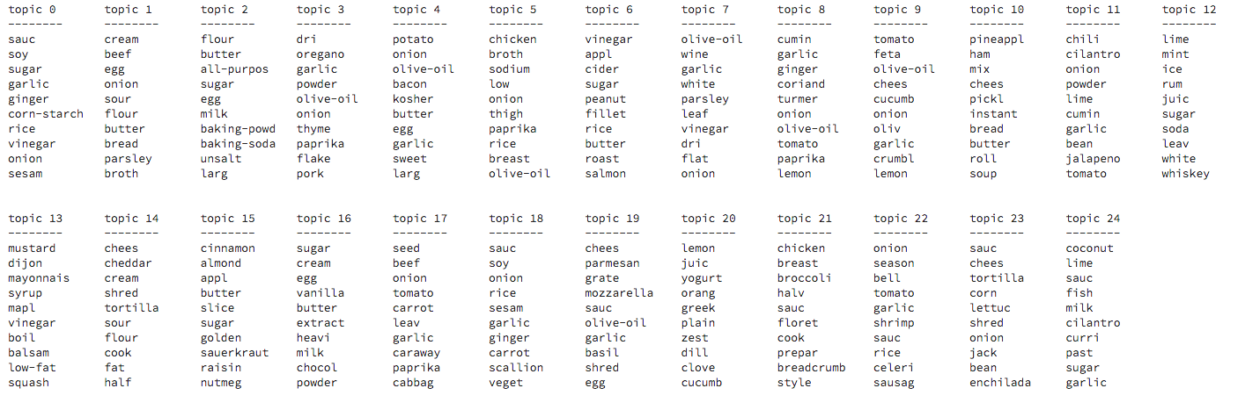
Results from LDA topic modeling showed that ingredients were grouped partially based on cuisine, but also based on category
Desserts
Cocktails
Sauces
Italian
Thai
Notes:
I also did an LDA model to see if it would be possible to separate out the different ingredients based on the cuisine they typically belong to. I specified the number of topics to be 25 because I knew there were 25 different cuisines represented in my dataset. What I observed was that ingredients were often times separated by category, such as
Click
Desserts
Click
Cocktails
Click
and sauces. However, some of the groups were clearly different types of cuisines like Italian and Thai.

Slide 9
Conclusions
PCA was applied to the recipe data in order to help us better visualize the relationship between different cuisines.
We were able to observe clear separations between different types of cuisines when plotting the centroid values along the first two principal components
Topic modeling using LDA was only partially effective at grouping ingredients based on cuisine
Notes:
So I’m almost PASTA time, so I’m going to have to CURRY with my conclusions!

Slide 10
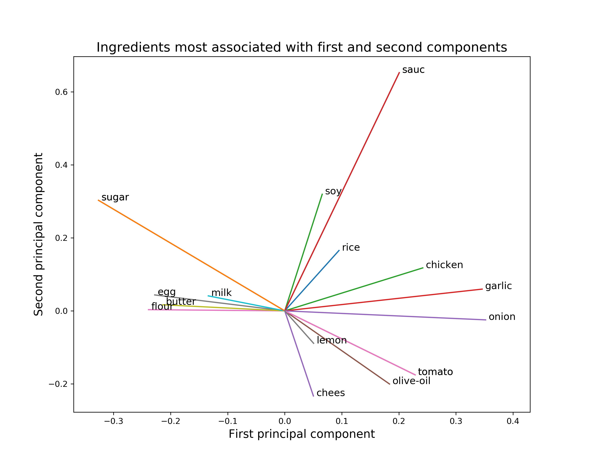
Appendix: A plot demonstrating the ingredients most strongly associated with the first two principal components
Notes:
This plot provides a visual representation of the dominate features for each of the two principal components. Ingredients such as chicken, garlic, onion, and tomato have strong associations along the positive direction of component one (These flavors have strong ties to cuisines such as Spanish or Indian) , whereas eggs, butter, flour, milk and sugar have strong associations along the negative direction of component one (These are ingredients found typically in French or English dishes). Likewise, soy, sauce, and rice have strong associates with the positive direction of component two (which have strong ties to Asian cuisine), and cheese, lemon, olive oil and tomato have strong associations with the negative direction of component two (which have ties to Italian or Greek cuisine).

Slide 11
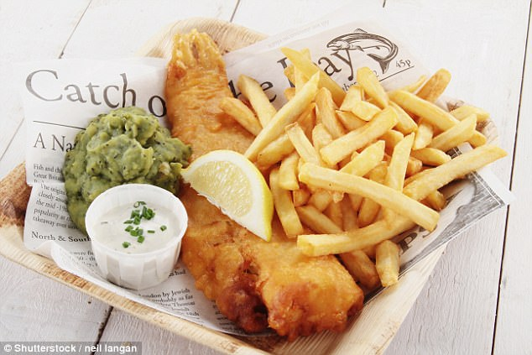
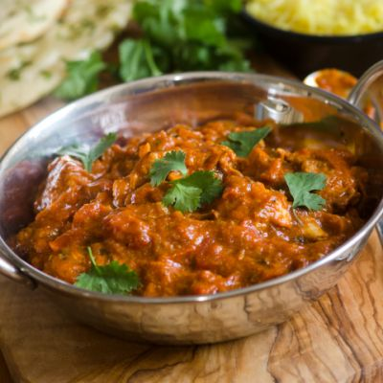
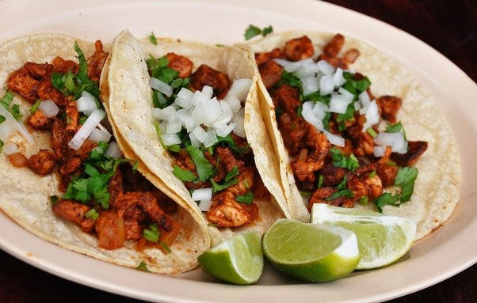
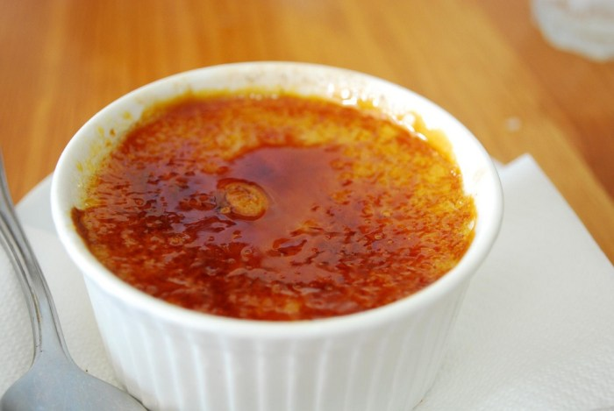
Appendix: The goal of my project was to use data science to gain insights of cuisines from around the world.
Questions I wanted to explore:
Spicy chicken curry
Which cuisines are most similar and which are most different?
Are there any unexpected relationships?
Can we use topic modeling to separate out different cuisines?
Fish and chips
savory
Tacos
Crème brulle
spicy
Notes:
The goal of my project was to gain insights of cuisines from around the world using data science techniques.
In particular, some questions I wanted to try and answer are:
- Which cuisines are most similar and which are most different?
Are there any unexpected relationships between the different cuisines?
Can we use topic modeling to separate out different cuisines?
Click
So, if you look at a plot of spicy on one axis and savory on another
Click
fish and chips might show up here
Click
spicy chicken curry might show up here
Click
tacos
Click
Crème brulle

